Slide 1

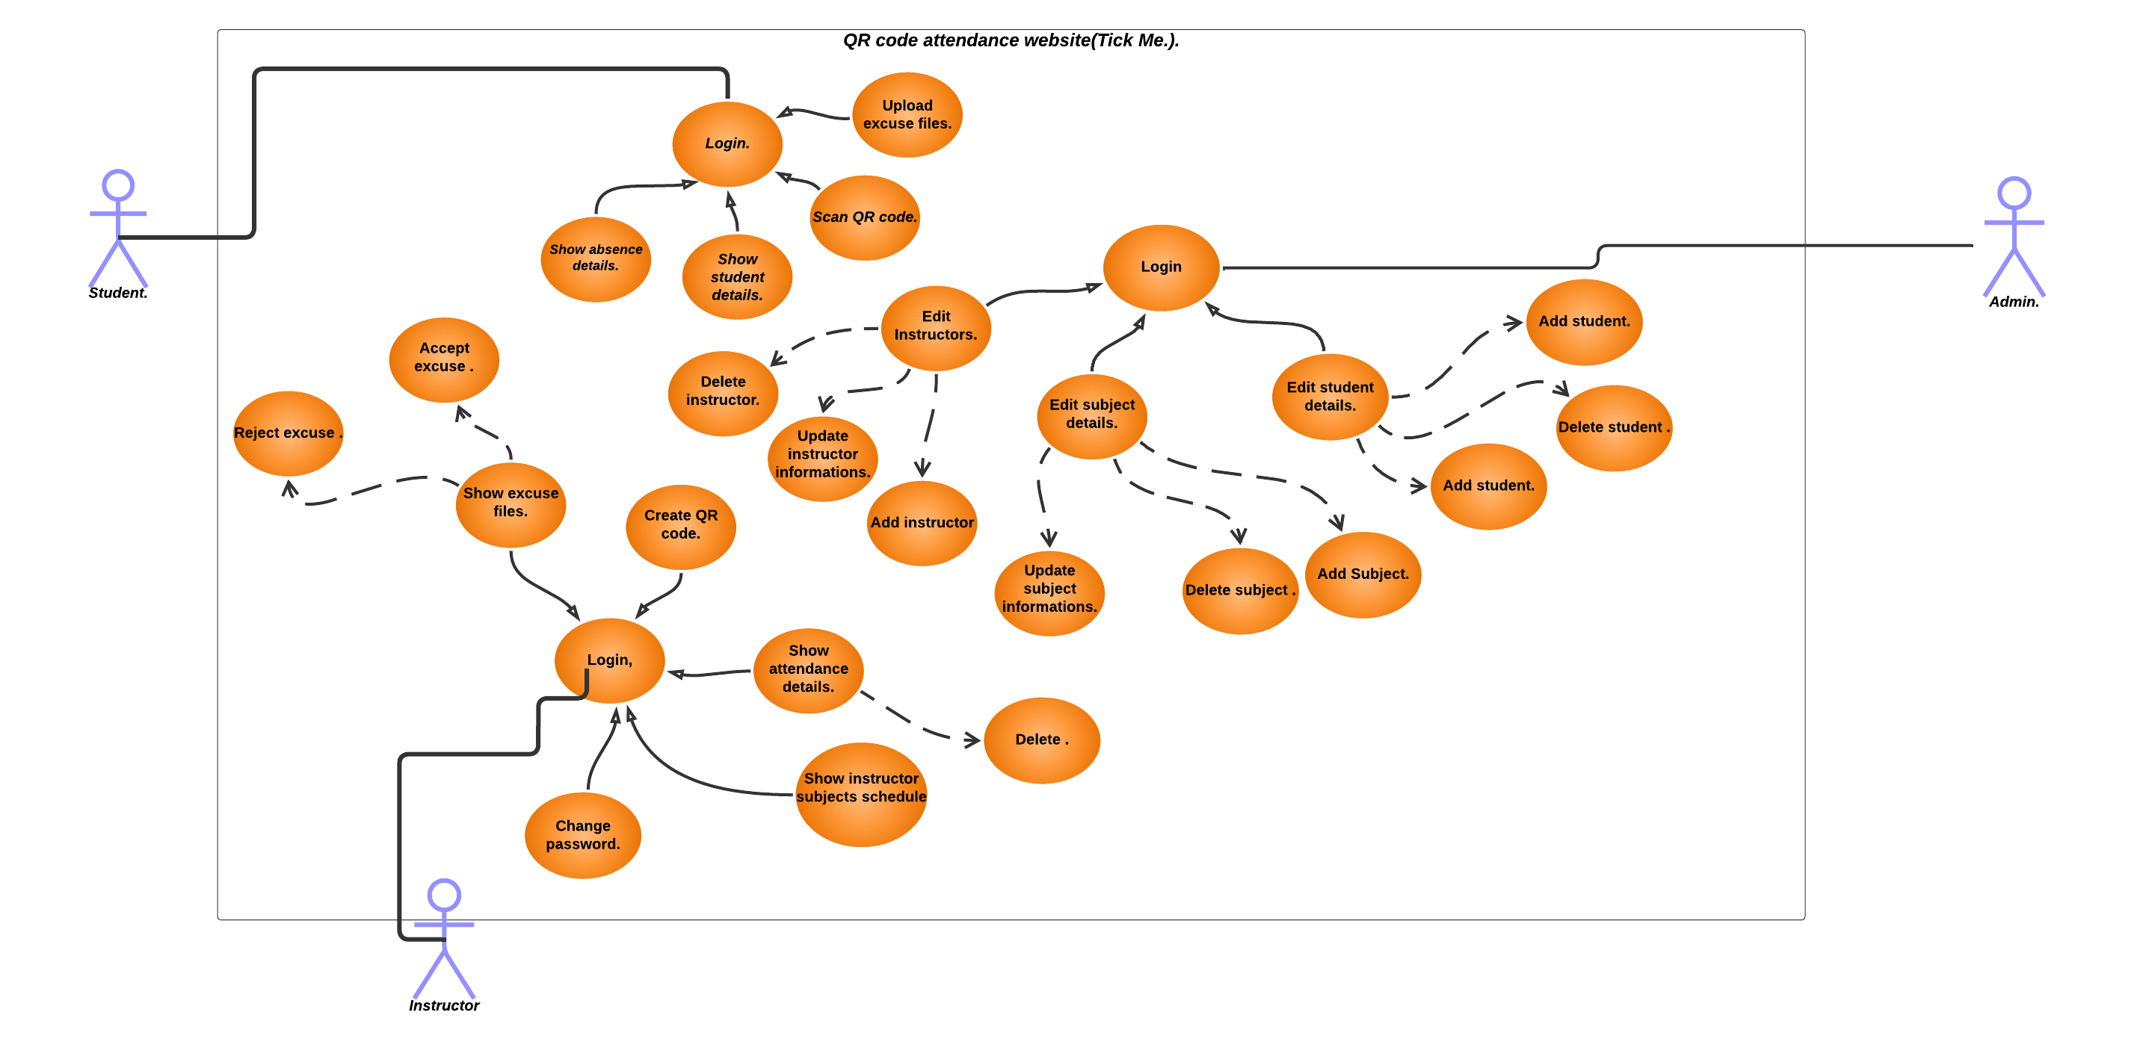
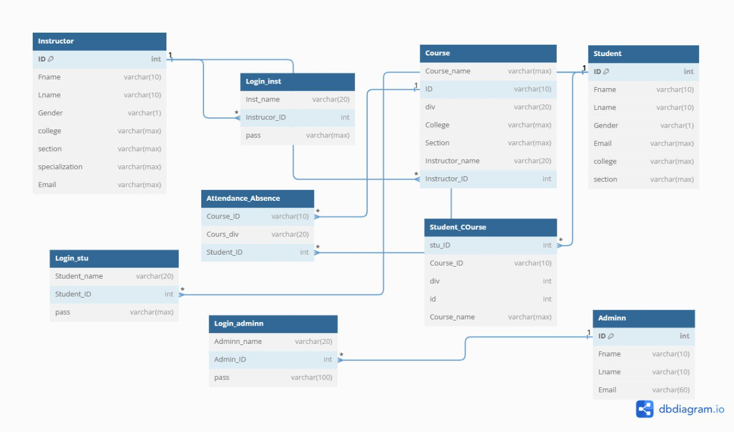
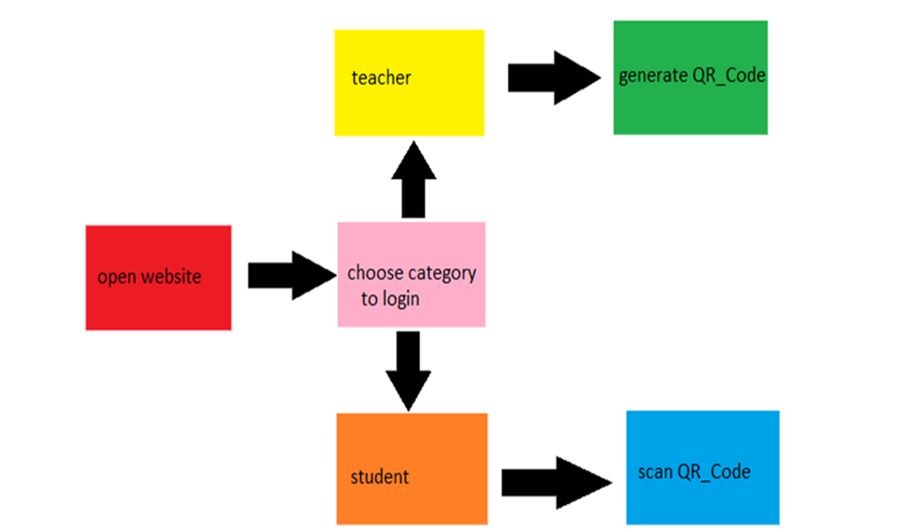

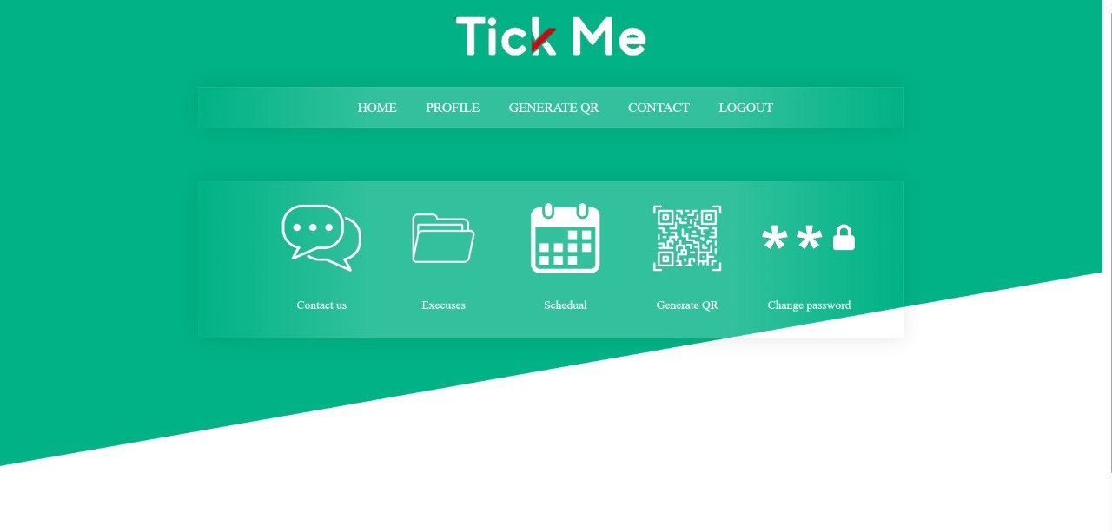
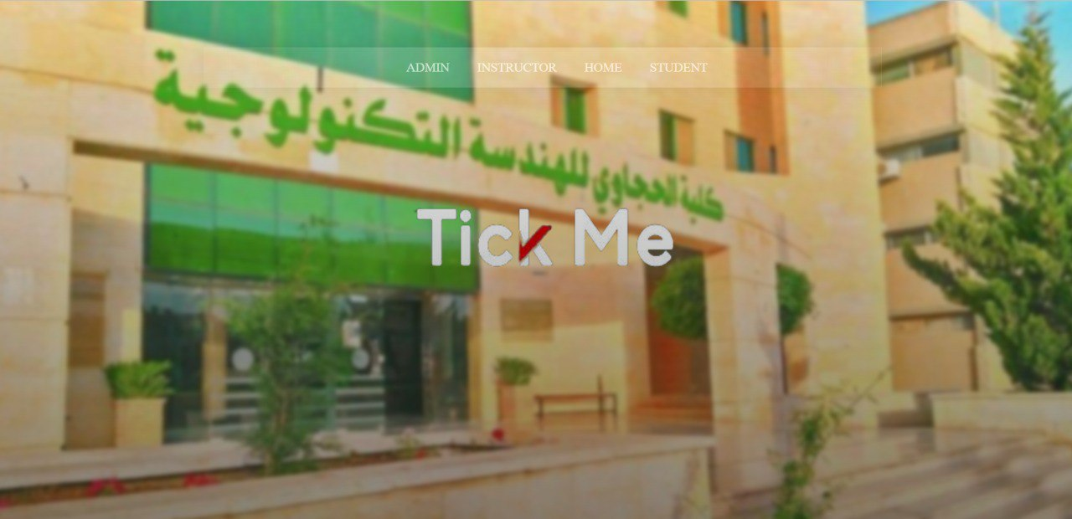

Students Attendance System based on QR Code and MAC Address
Dana Mustafa and Jana Massadeh
Supervisor: Prof. Amin Alqudah
Abstract
TickMe a university website To take attendance and absence electronically, with its full approval on the QR code.
Introduction
It is an idea based on an easy-to-use website with many uses Tick me. Where each student needs to scan the QR code using the phone's camera to confirm his attendance, the site will also verify the identity of the student through the IP address For each phone and the site will automatically create different QR code different every five seconds, and thus we have achieved the prevention of false registrations.
Instructor
Figure 2: Use case.
Figure 6: Database.
Implementation
Several programming language are used in our website (TickMe) with Asp.net Framework.
-On the front end (user side), we used Html,CSS and JavaScript.
-On the backend (server side), we used C#.
For the database ,we use SQL server management studio (SSMS).
Figure 3: Admin Home.
Results and Discussion
Figure 1: The Proposed Methodology
1-Save time and effort and use it to give the lecture
2-Follow the student's attendance with ease. and evaluate it.
3.Facilitating the student to present his excuses for not attending his lectures or exams.
4-Taking attendance and absence daily.
Design
On our website, the instructor can take attendance and absence electronically, easily and smoothly, without the need to exert effort and waste time, and evaluate the student based on his attendance, and it allows the student to track the days of his attendance, absence., and his status in the course.
Conclusions
The main contributions of this work include the development and implementation of a comprehensive gym application. This application offers a user-friendly feature such as sign-in/sign-up pages, a main page with class schedules, a forgot password page with OTP verification, and an administrative dashboard for managing member details, class registrations, and payments. Overall, the main contributions of this work lie in the successful design and implementation of an efficient gym system application.
Figure 4: Instructor Home.
Figure 2: Home
Figure 5: Student Home.
Hijjawi Faculty for Engineering Technology
Computer Engineering Department
Graduation Projects – 2nd semester 2023

